Slide 1
Unit-II
Large Scale Fading
WEEK1 : Introduction to Radio wave Propagation, Large scale and small scale fading, Friis transmission equation- Free space propagation model - pathloss model, Two Ray model
WEEK2 : Two Ray model (Contd), Simplified pathloss model, Emperical model - Okumara, Emperical model - Hata model, Walfish and bertoni model, Piecewise linear model - log normal model
WEEK3 : Shadowing, Combined pathloss and shadowing, Outage ProbabilIty, Cell Coverage Area, Solving problems – Brewster angle, Solving problems –empirical model, Solving problems – friis transmission formula
Path Loss
Text books, references:
Rappaport T.S, “Wireless Communications: Principles and Practice”, Pearson education
Andrea Goldsmith, “Wireless Communications”, Cambridge University Press, Aug 2005

Slide 2
WEEK 1 LECTURES
Introduction to Radio wave Propagation, Large scale and small scale fading, Friis transmission equation- Free space propagation model - pathloss model, Two Ray model
Courtesy:
Rappaport T.S, “Wireless Communications: Principles and Practice”, Pearson education.

Slide 3
Introduction to Radio Wave Propagation
Follows the principle of Electromagnetic wave propagation
reflection
diffraction
scattering
Problems with urban areas
No direct line-of-sight
high-rise buildings causes severe diffraction loss
multipath fading due to different paths of varying lengths
Large-scale propagation models predict the mean signal strength for an arbitrary Transmitter-Receiver separation distance. (generally for a larger distance).
Small-scale (fading) models characterize the rapid fluctuations of the received signal strength over very short travel distance or short time duration.

Slide 4
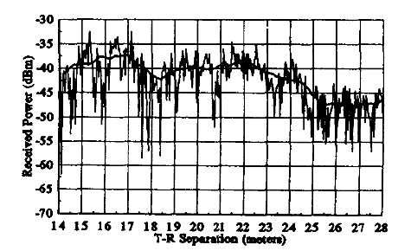
Large scale and Small scale fading

Slide 5
Radio wave propagation
Line of sight The line-of-sight (LOS) propagation is the wave propagation in which the EM ray follows a straight line from the transmitter to the receiver. It is shown as a direct ray in the next figure.
Non-line of sight The non-line-of-sight (NLOS) propagation mechanism is based on and is the resultant of the following mechanisms:
Reflection This occurs when the propagating wave impinges on an object that is larger than its wavelength. Examples of such objects are the surface of the earth, buildings, and walls.
Diffraction This occurs when the radio path between the transmitter and the receiver is obstructed by a surface with sharp irregular edges, which results in the waves bending around the obstacle. Diffraction is more with low- frequency (LF) signals than with high-frequency (HF)
Scattering This occurs when the propagating wave is obstructed by objects that are smaller than its wavelength. Examples of such objects are lamp posts, foliage, street signs, and particles in the air.
Refraction Due to variations in the refractive index of the atmospheric layers, the EM wave bends (in the cases other than satellite communication).

Slide 6
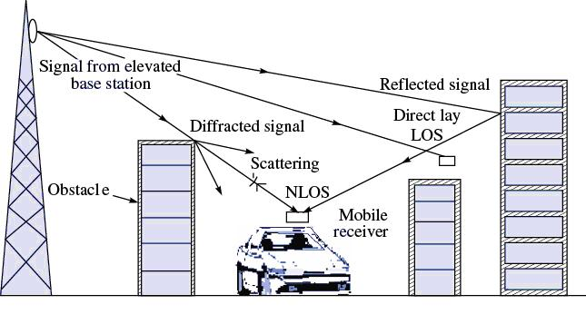
T-R Signal variations

Slide 7
Propagation Channel Effects
Attenuation It is the drop in the signal power when it is being transmitted from one point to another. It is caused by the transmission path length, obstructions in the signal path, and multipath effect.
Fading As there are obstacles and reflectors in the wireless propagation channel, the transmitted signal arrives at the receiver from various directions over multiple paths. Such a phenomenon is called multipath. Fading is the result of multipath in which the signal strength varies continuously with respect to distance and with time from the transmitter to the receiver along with the attenuation
Shadowing This occurs whenever there is an obstruction between the transmitter and the receiver, and it can be observed in long-distance as well as short distance communication. It is generally caused by buildings and hills.

Slide 8
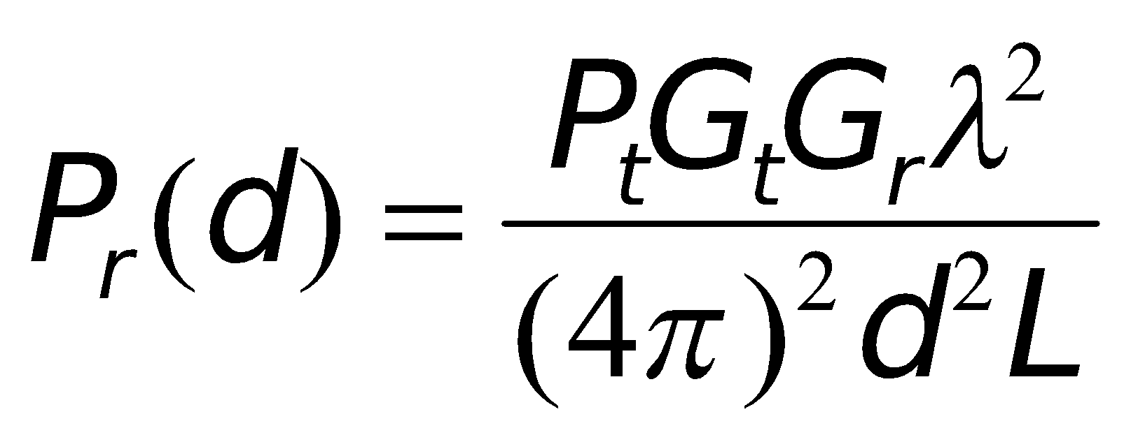
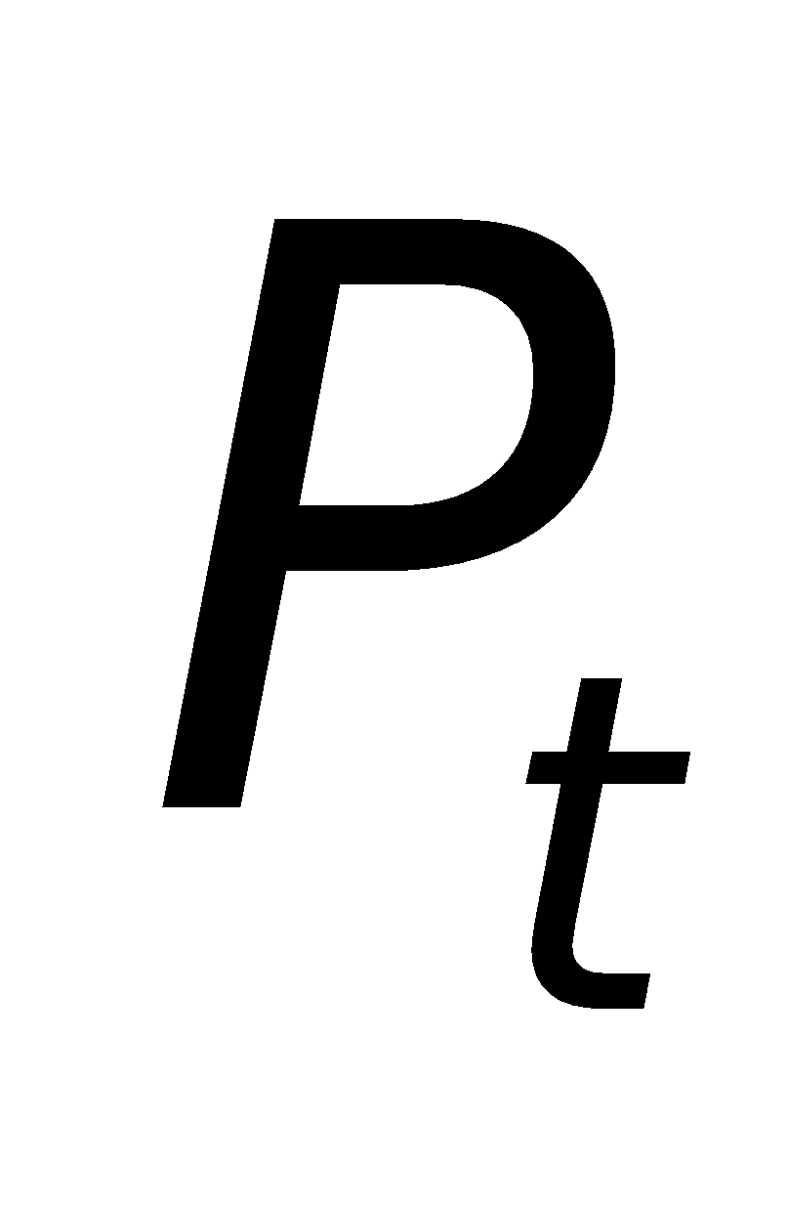

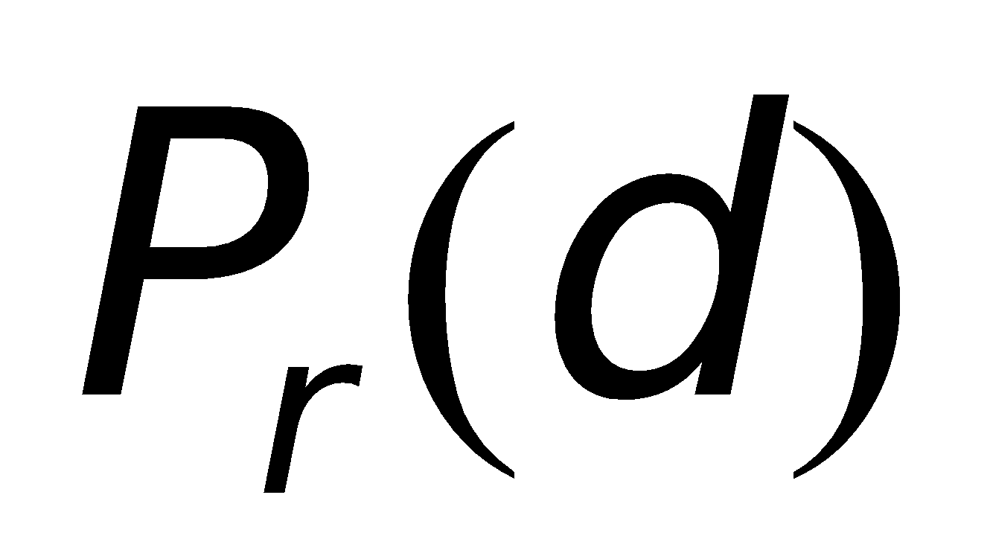

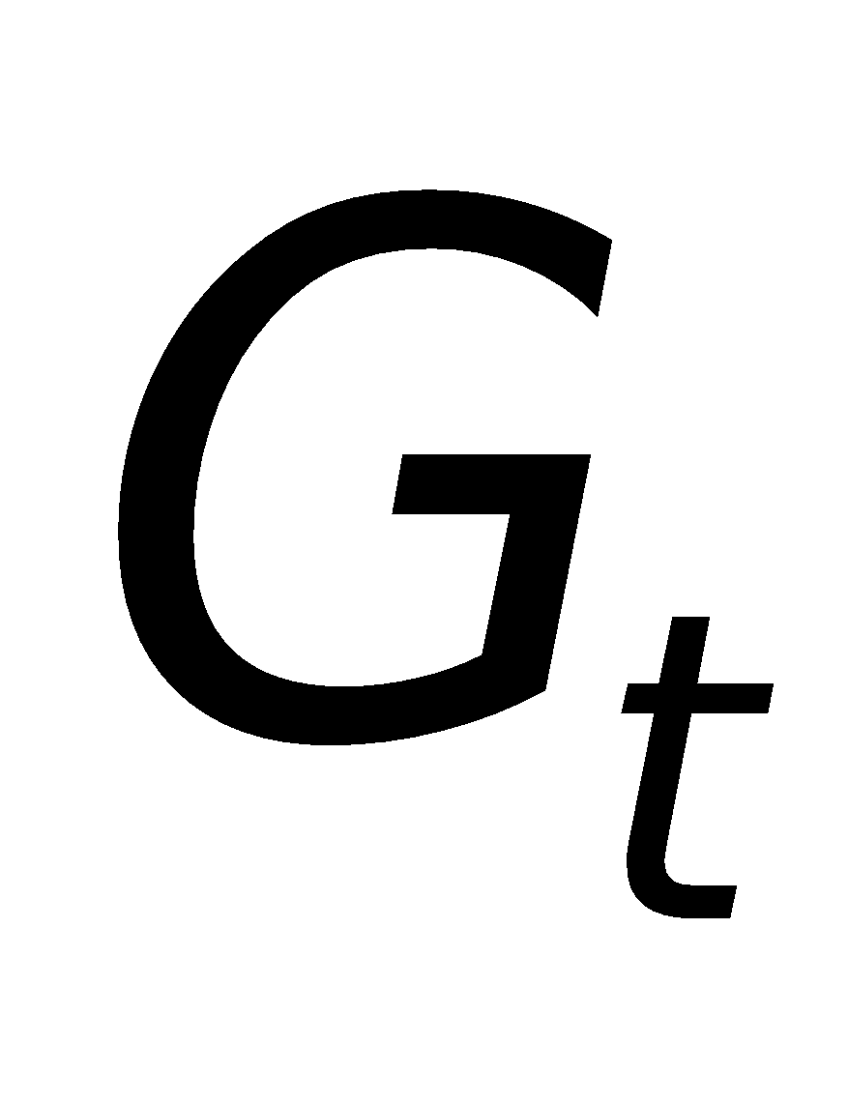
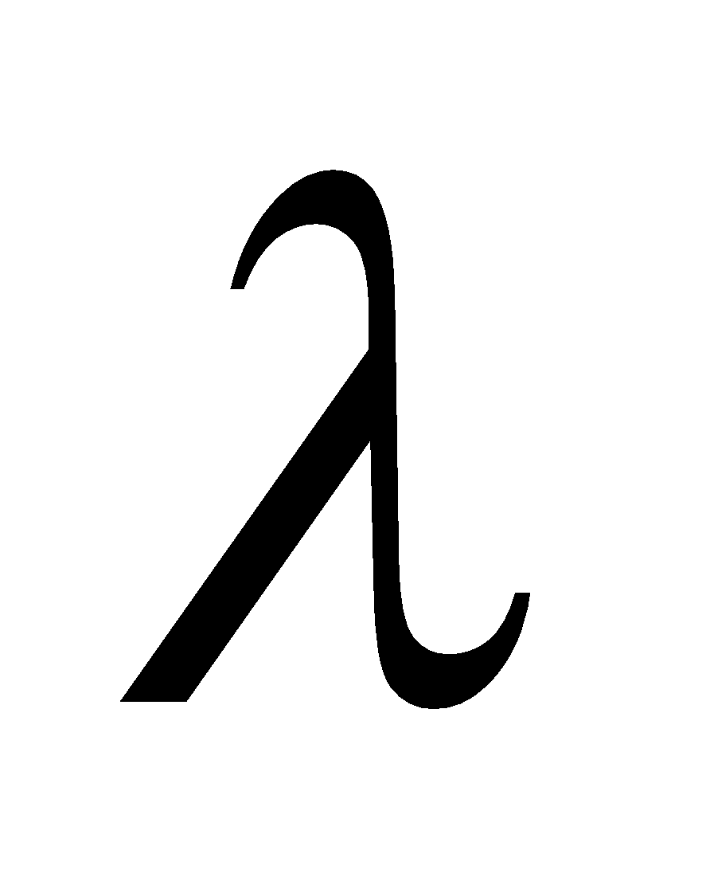
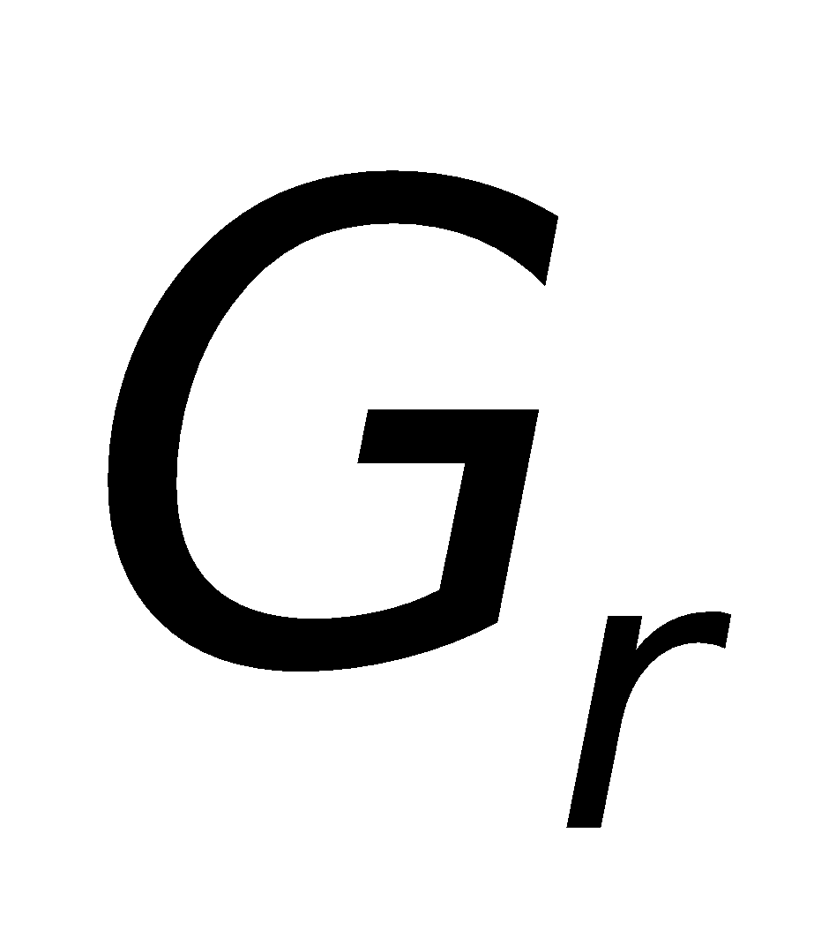
Free Space Propagation Model
The free space propagation model is used to predict received signal strength when the transmitter and receiver have a clear line-of-sight path between them.
satellite communication
microwave line-of-sight radio link
Friis free space equation
: transmitted power : T-R separation distance (m)
: received power : system loss factor
: transmitter antenna gain : wave length in meters
: receiver antenna gain

Slide 9
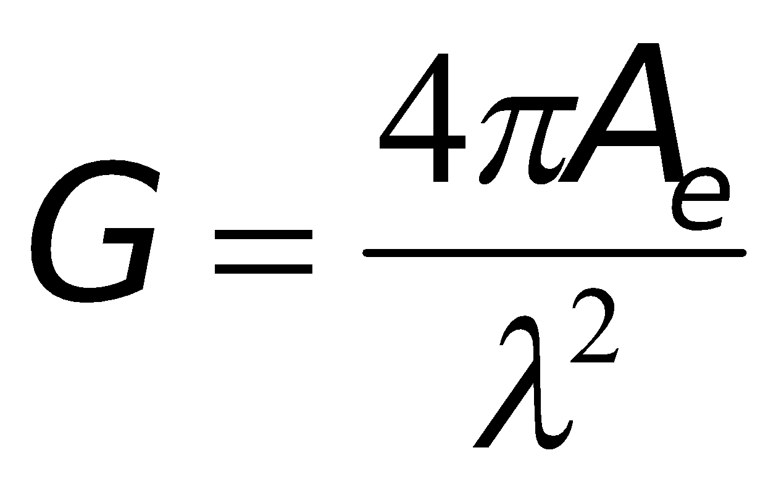

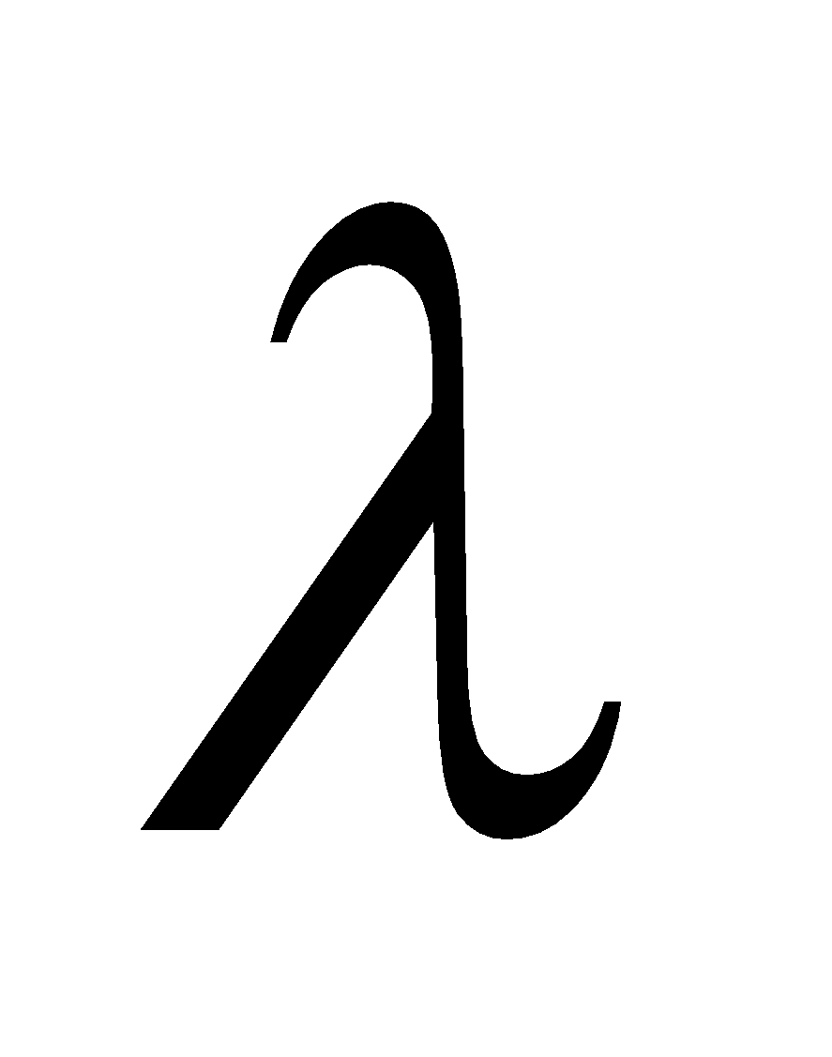
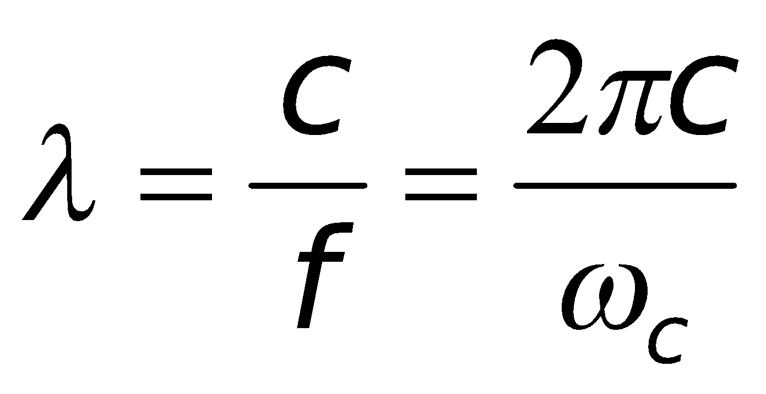




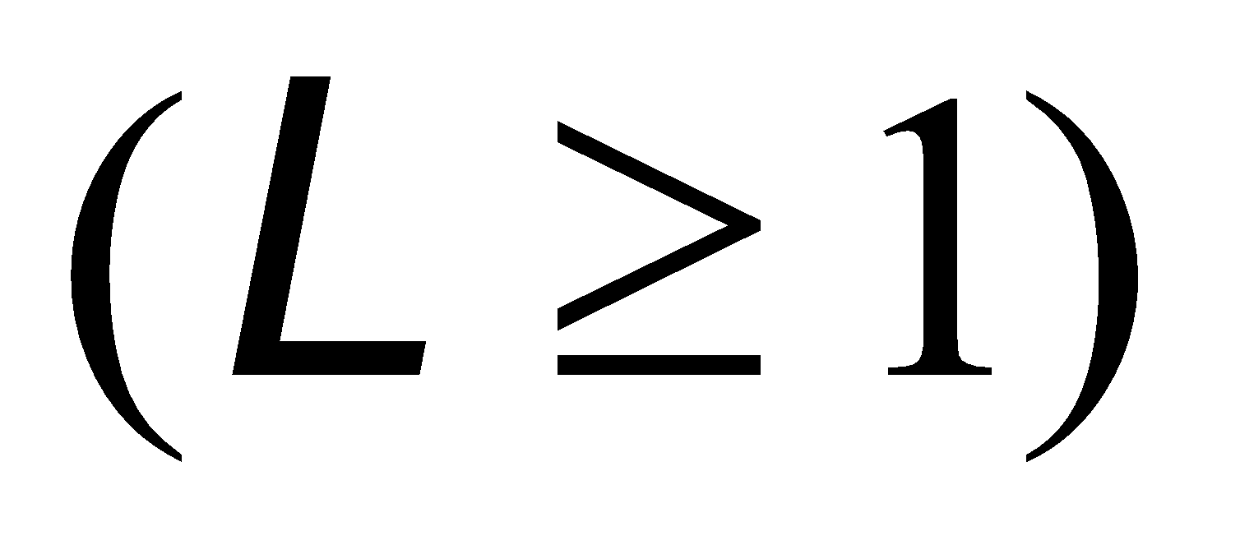
The gain of the antenna
: effective aperture is related to the physical size of the antenna
The wave length is related to the carrier frequency by
: carrier frequency in Hertz
: carrier frequency in radians
: speed of light (meters/s)
The losses are usually due to transmission line attenuation, filter losses, and antenna losses in the communication system. A value of L=1 indicates no loss in the system hardware.

Slide 10

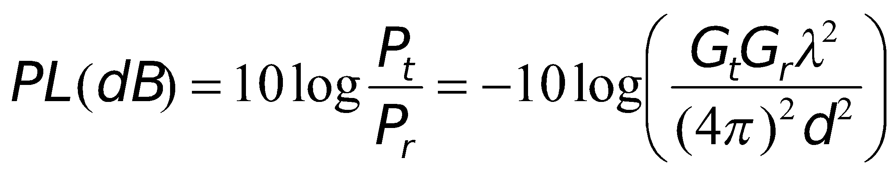
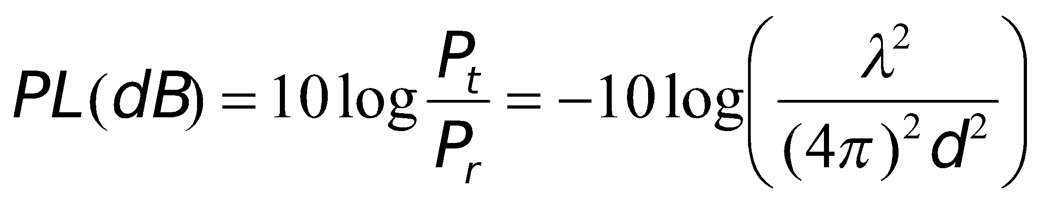
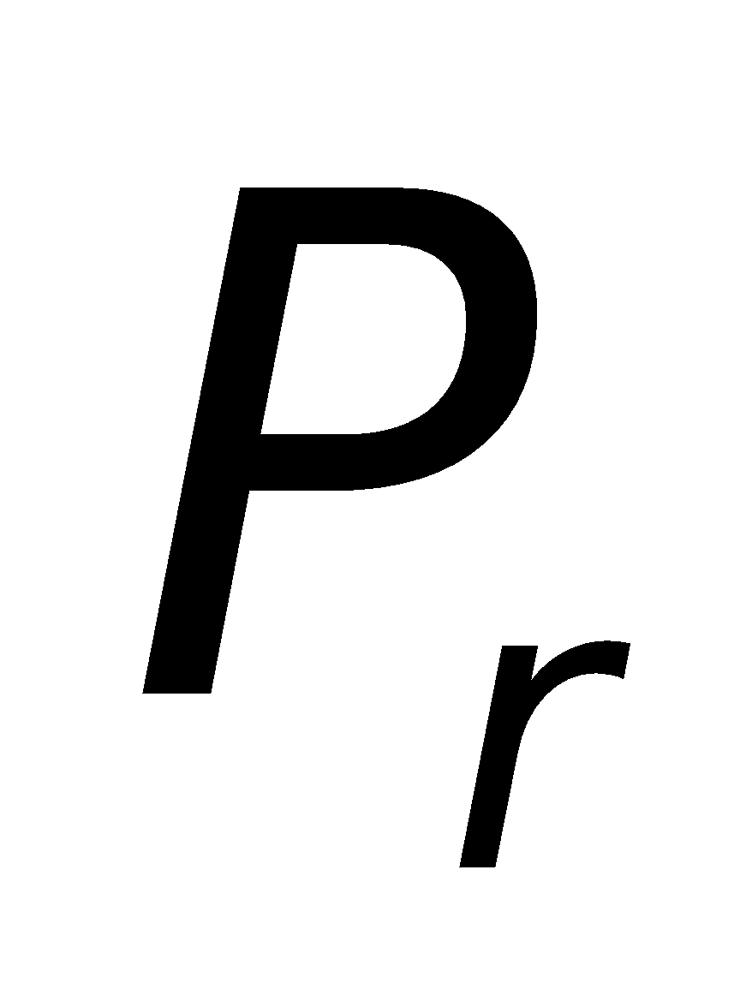
Isotropic radiator is an ideal antenna which radiates power with unit gain.
Effective isotropic radiated power (EIRP) is defined as
and represents the maximum radiated power available from transmitter in the direction of maximum antenna gain as compared to an isotropic radiator.
Path loss for the free space model with antenna gains
When antenna gains are excluded
The Friis free space model is only a valid predictor for , for values of d which is in the far-field (Fraunhofer region) of the transmission antenna.

Slide 11
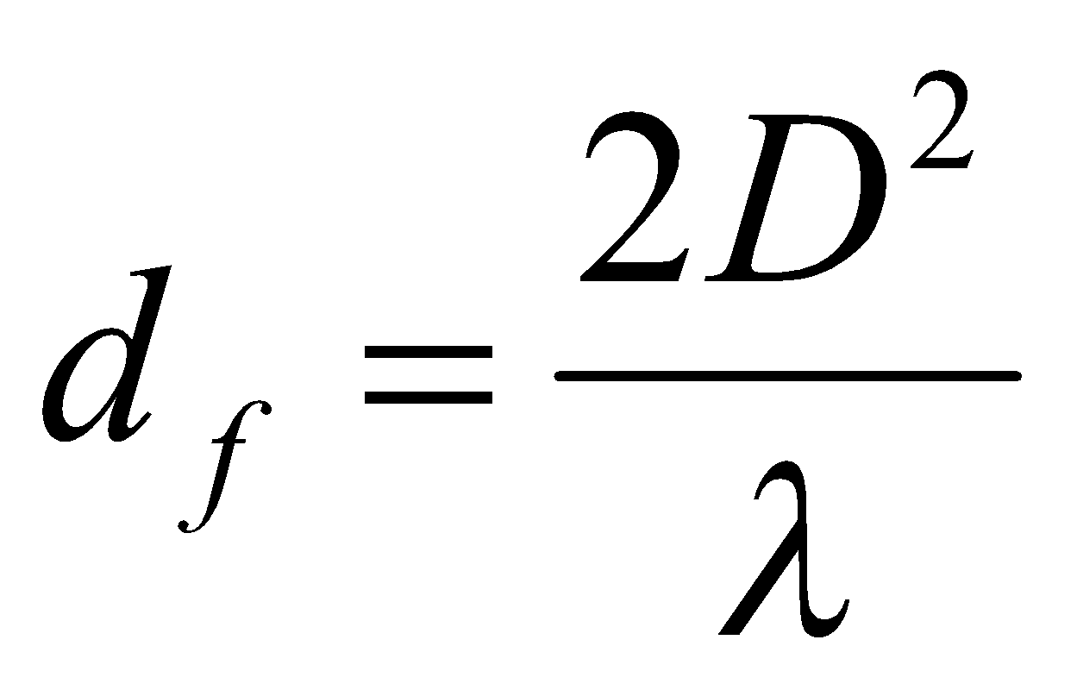
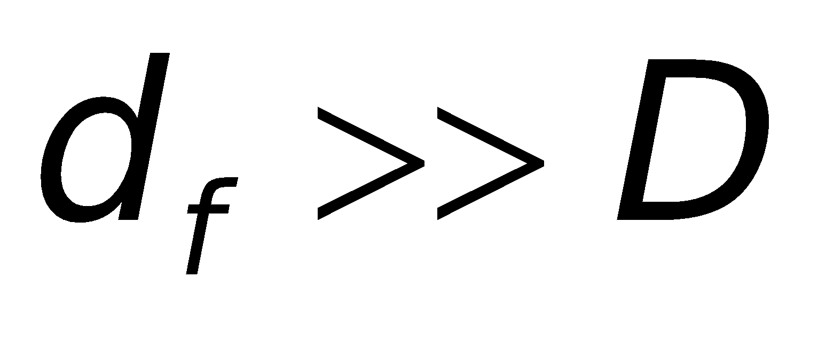
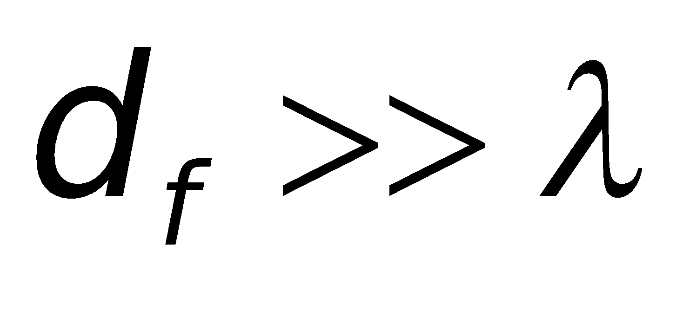
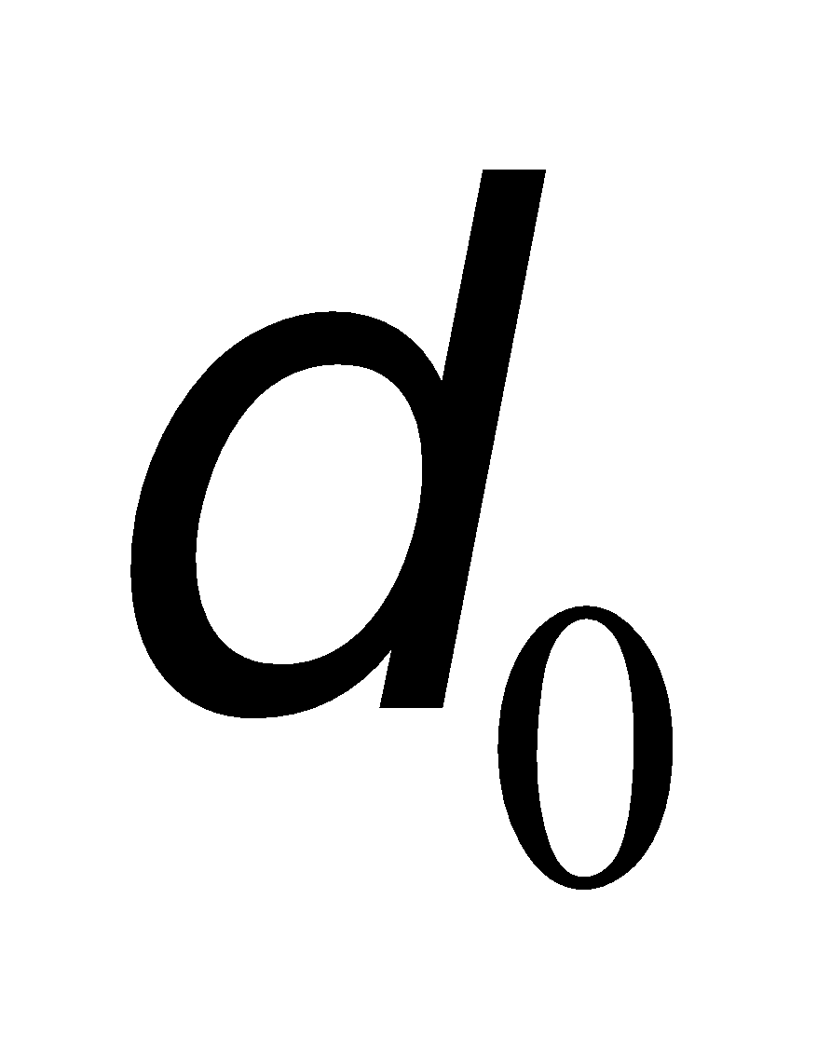
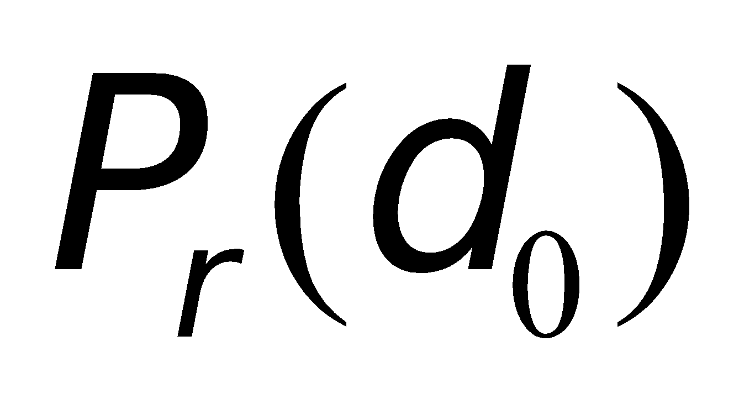
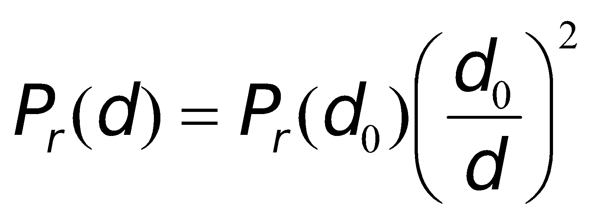
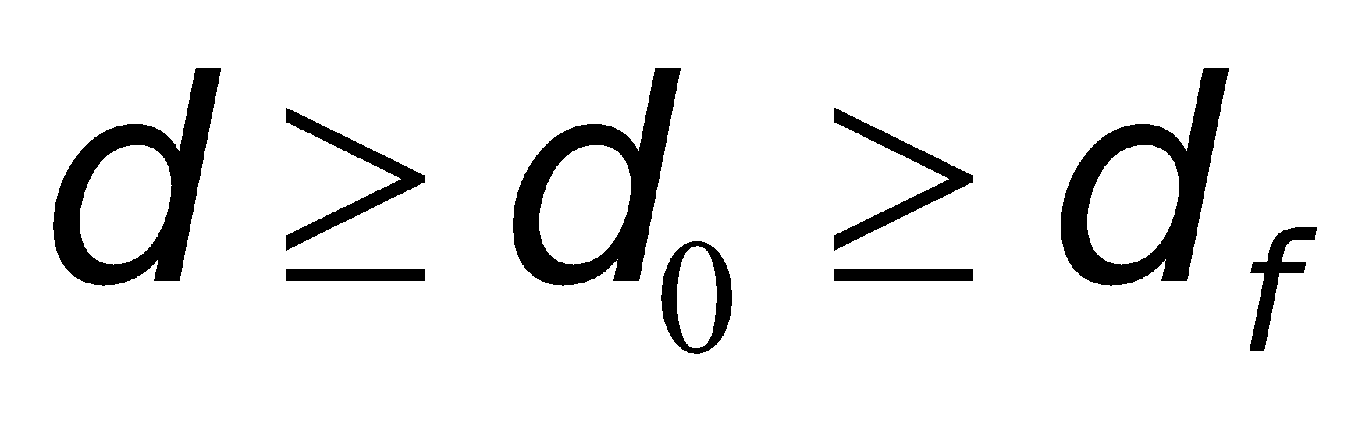
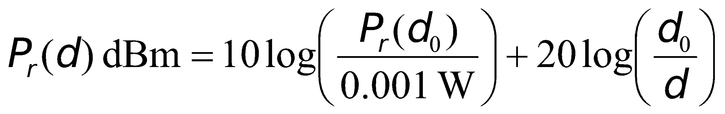
The far-field region of a transmitting antenna is defined as the region beyond the far-field distance
where D is the largest physical linear dimension of the antenna.
To be in the far-filed region the following equations must be satisfied
and
Furthermore the following equation does not hold for d=0.
Use close-in distance and a known received power at that point
or

Slide 12
The Three Basic Propagation Mechanisms
Basic propagation mechanisms
Reflection
Diffraction
Scattering
Reflection occurs when a propagating electromagnetic wave impinges upon an object which has very large dimensions when compared to the wavelength, e.g., buildings, walls.
Diffraction occurs when the radio path between the transmitter and receiver is obstructed by a surface that has sharp edges.
Waves bend around the obstacle, when LOS (line of sight) does not exist
Scattering occurs when the medium through which the wave travels consists of objects with dimensions that are small compared to the wavelength.

Slide 13
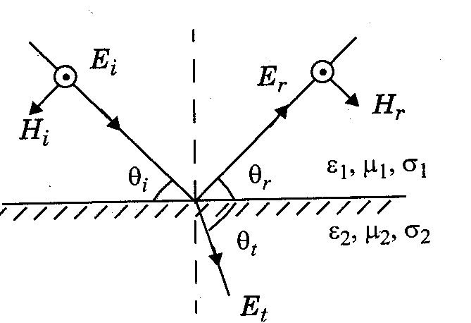
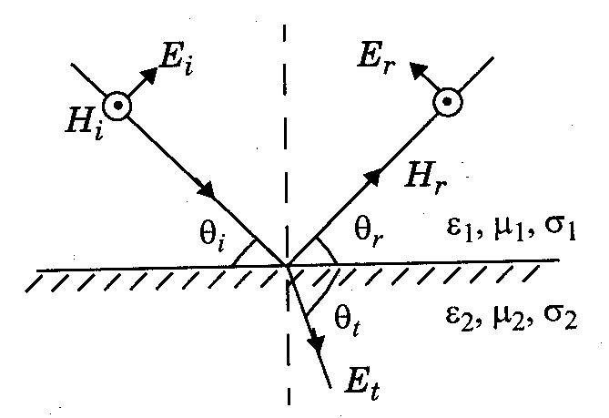
Reflection
Reflection from dielectrics:
E-field normal to the plane of incidence E-field in the plane of incidence
Reflection from perfect Conductors:
E-field in the plane of incidence
θ_{i} = θ_{r} and E_{i} = E_{r}
E-field normal to the plane of incidence
θ_{i} = θ_{r} and E_{i} = -E_{r}

Slide 14
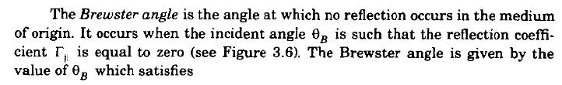


Reflection (contd…)

Slide 15
Scattering
Scattering occurs when the medium through which the wave travels consists of objects with dimensions that are small compared to the wavelength, and where the number of obstacles per unit volume is large.
Scattered waves are produced by
rough surfaces,
small objects,
or by other irregularities in the channel.
Scattering is caused by trees, lamp posts, towers, etc.

Slide 16
Scattering (contd…)
Received signal strength is often stronger than that predicted by reflection/diffraction models alone
The EM wave incident upon a rough or complex surface is scattered in many directions and provides more energy at a receiver
energy that would have been absorbed is instead reflected to the Rx.
flat surface → EM reflection (one direction)
rough surface → EM scattering (many directions)

Slide 17
Diffraction
RF energy can propagate:
around the curved surface of the Earth
beyond the line-of-sight horizon
Behind obstructions
Although EM field strength decays rapidly as Rx moves deeper into “shadowed” or obstructed (OBS) region
The diffraction field often has sufficient strength to produce a useful signal

Slide 18
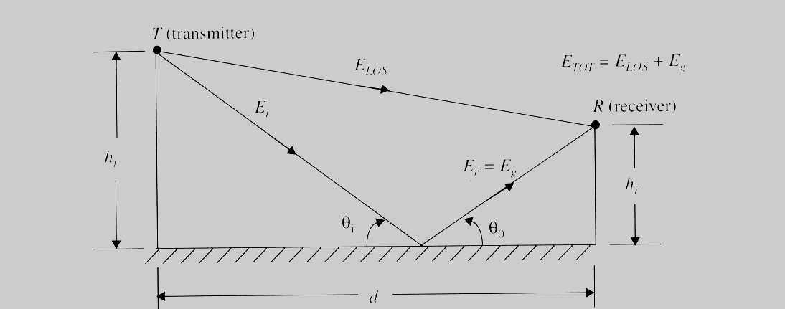
Classical 2-ray Ground Bounce Model
Two-ray ground reflection model
(Wireless Communications by Theodore Rappaport)
Notes:
Fig. 2.5

Slide 19
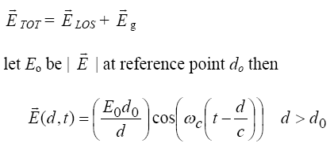


Classical 2-ray Ground Bounce Model
ETOT is the electric field that results from a combination of a direct line-of-sight path and a ground reflected path
is the amplitude of the electric field at distance d
ω_{c} = 2πf_{c} where f_{c} is the carrier frequency of the signal
Notice at different distances d the wave is at a different phase because of the form similar to

Slide 20


Classical 2-ray Ground Bounce Model
For the direct path let d = d’ ; for the reflected path
d = d” then
for large T−R separation : θ_{i} goes to 0 (angle of incidence to the ground of the reflected wave) and Γ = −1 (perfect horizontal E field polarization and ground wave reflection)
Phase difference can occur depending on the phase difference between direct and reflected E fields
The phase difference is θ∆ due to Path difference , ∆ = d”− d’, between
Notes:
ase difference
Path difference

Slide 21
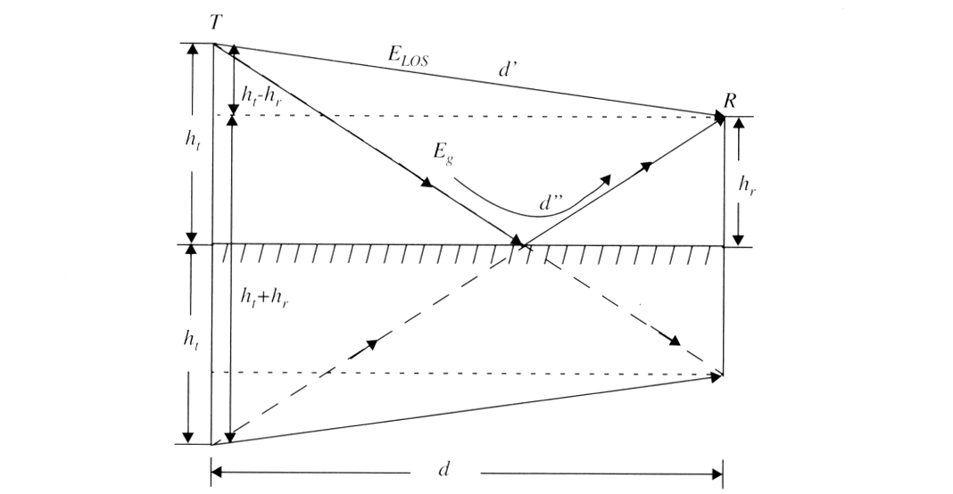
Method of Images
The method of images is used to find the path difference between the LOS and the ground reflected paths
(Wireless Communications by Theodore Rappaport)
Notes:
Fig. 2.6

Slide 22
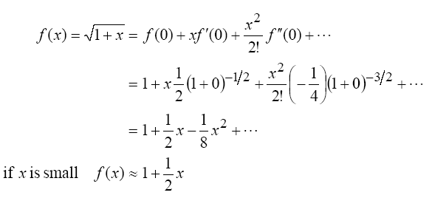
∆ can be expanded using a Taylor series expansion

Slide 23
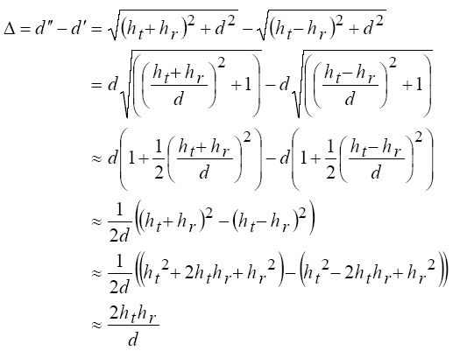


which works well for d >> (h_{t} + h_{r}), which means
and are small

